Slide 1
Capstone Project-Final Presentation
Tourist Sites for Tourist to London and Chicago
By
Adesola Latona
For Coursera Capstone Project

Slide 2
REPORT CONTENT
1. Introduction Section : ⁃ Discussion of the business problem and the
interested audience in this project.
2. Data Section:
⁃ Description of the data that will be used to solve the problem and the
sources.
3. Methodology section ⁃ Discussion and description of exploratory data
analysis carried out, any inferential statistical testing performed, and if
any machine learnings were used establishing the strategy and
purposes.
4. Results section ⁃ Discussion of the results.
5. Discussion & Conclusion ⁃ Discussion on any observations noted and
report conclusion.

Slide 3
Description of the Problem and Background
Scenario:
I am a data scientist residing in Rapid City,South Dakota. I currently work with a popular travel agency in the city as the resident data scientist where I make recommendations on proposed tourist sites for our various clients with travel destination to almost anywhere in the world. A couple of Italians living in my city are going for a conference in London,United Kingdom for a few days and upon returning to the United States will like to visit the windy city, Chicago,Illinois for about a week. With hotels already booked in the two cities, I have been saddled with the responsibilities of making the trip to London and Chicago memorable for the intending tourist. The requests of the tourist include finding locations around the hotel that has the following places of interest in London:
High-end Boutiques
Italian Restaurants
Intercontinental Restaurants
Departmental stores
For the Chicago location, clients wants the 3 best Italian restaurants around the proposed location.
In order to make a good recommendations, I have decided to use the skills I leanrt in my IBM Data Science program to solve the requests.

Slide 4
Business Problem:
The challenge is to find good tourist sites for our clients based on their proposals for London and Chicago.
Interested Audience:
I believe this is a relevant challenge with valid questions and answers for my clients and anyone intending to go on holiday in London and Chicago. Going on holidays without adequate information can pose unforseen problems and also make the visit(s) not enjoyable.

Slide 5
Data Section: Description of the data and its sources that will be used to solve the problem
Description of the Data:
The following data is required to answer the issues of the problem and allow for proper decision making:
List of Italian restaurants and the distances with their geodata (latitude and longitude)
List of Intercontinental restaurants with their address location
List of high-end boutiques with their addresses
Rating of the three closest Italian restaurants in the city of Chicago and their addresses
Map of each neighborhoods to aid navigation

Slide 6
How the data will be used to solve the problem
The data will be used as follows:
Use Foursquare and geopy data to map top 10 venues for all London City neighborhoods and top 30 for City of Chicago neighborhood as they intend to spend more time in Chicago ( as per Course LAB)
Use foursquare and geopy data to map the location of Italian resturants , separately and on top of the above clustered map in order to be able to identify the venues and ammenities near each restaurants.
create a map that depicts, for instance, the average rental price per square ft, around a radious of 1.0 mile (1.6 km) around each subway station - or a similar metrics. I will be able to quickly point to the popups to know the relative price per subway area.
Use the foursquare venue search,explore and rating functions to get necessary information as required and convert to dataframe for use of the clients

Slide 7
How the data will be used to solve the problem (cont’d)
The processing of these DATA will allow to answer the key questions to make a decision:
what are the closest tourist sites as per the clients request that are close to the clients hotel?
what are the list of the best Italian resturants in the city of Chicago with further review for best?
What are the best places for intercontinental dishes closest to the hotel?

Slide 8
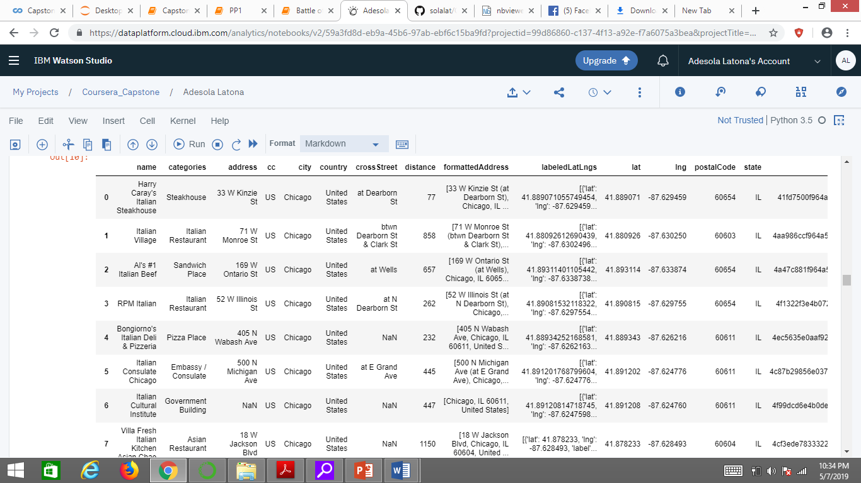
Italian Restaurants near The Hotel Chicago

Slide 9
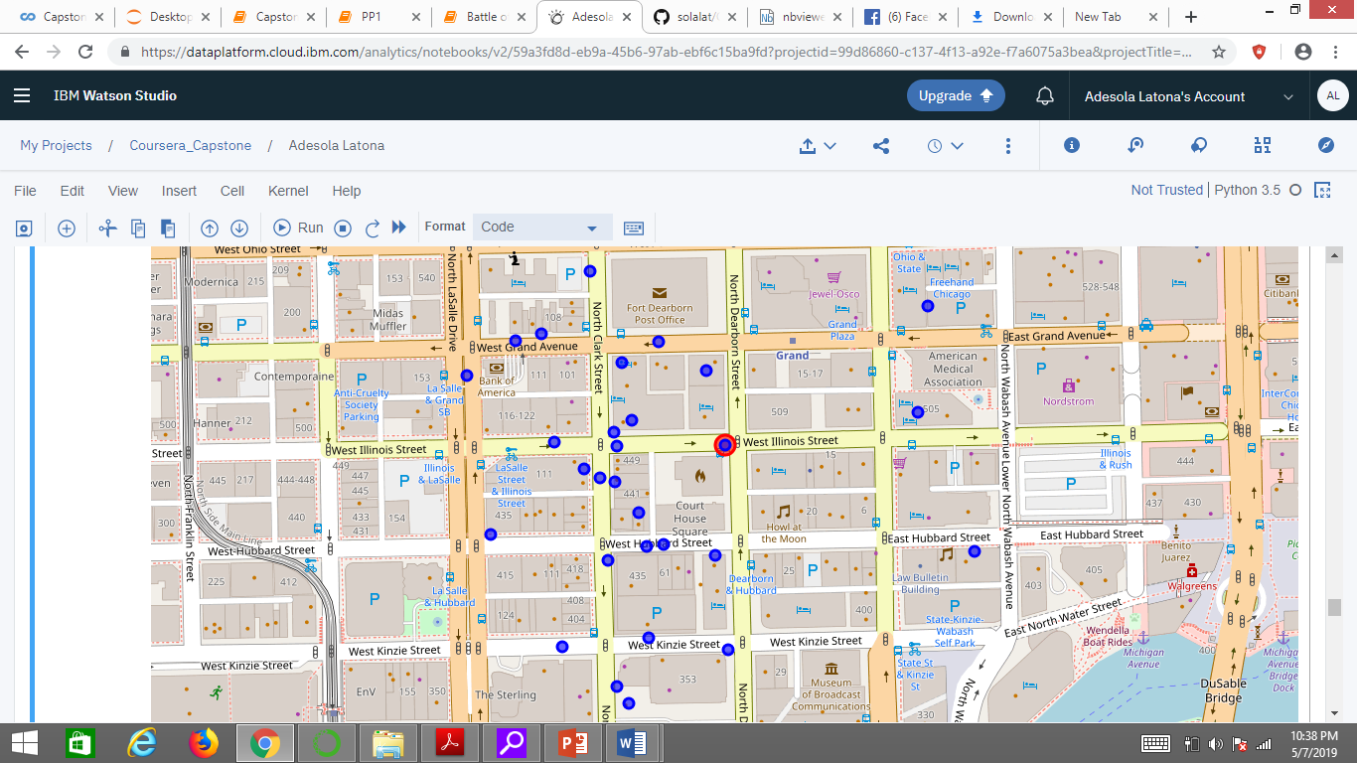
Map of restaurants around the Hotel

Slide 10
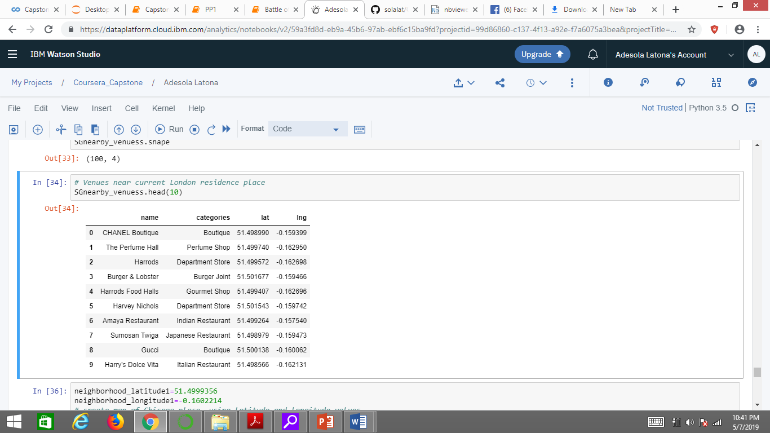
Sites around Millennium Hotel London Knightsbridge

Slide 11
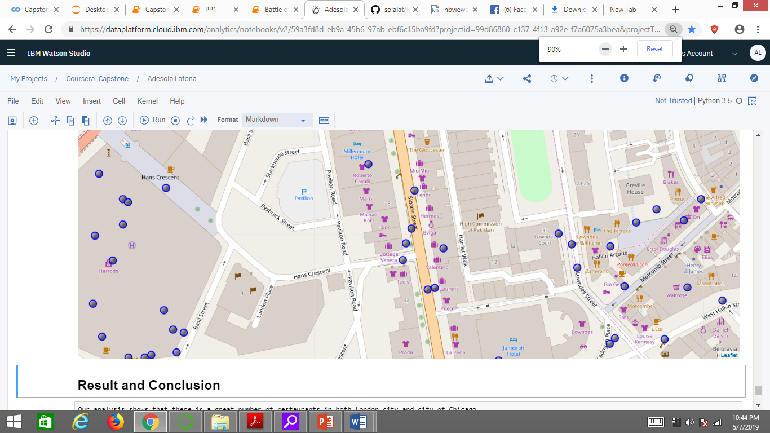
Sites around the Hotel

Slide 12
Result and Conclusion
Our analysis shows that there is a great number of restaurants in both London city and city of Chicago.
And based on the clients requests we are able to provide detailed information to the clients in order to make there trips to both cities eventful and memorable.
In the city of Chicago, we are able to recommend to the client the most rated Italian restaurant close to the hotel with other options and distances from the hotel should the need arises to explore other locations with the detailed map alongside it.
For London city, based on the client's request for detailed information on intercontinental dishes and high-end boutiques with departmental stores, we are able to give detailed recommendations alongside detailed map for further exploration

